Slide 1
Natural Disasters & Crisis Management in Italy. The Role of Public Relations & Communication Management
Sept. 23, 2022
Giulia Armuzzi & Biagio Oppi

Slide 2
Summary
Introduction
The Charter di Rieti
Theoretical Approach
Principles/behaviors
Case Histories
Conclusions

Slide 3
The Charter of Rieti
A theoretical approach to Natural Disaster communication

Slide 4
What the Rieti Charter is
9 behaviors to be adopted in environmental and natural crisis contexts for the management of:
Communication: the organizations that communicate on the ground
Information: the telling of facts in the media and social media
Relationship Governance: the management of relationship with stakeholders

Slide 5
Who the Rieti Charter is for
Actors involved in environmental crises and natural disasters are:
Profit and Non-Profit Organizations
Public Entities
Media
The paper is aimed at those involved in communication, information and relations in these actors.
It was born in Rieti during the reflections that emerged during the Central Italy Earthquake. The Call to Action is launched in the volume edited by Domenico Pompili, Stefano Martello and Biagio Oppi, presented in December 2018 at the Diocese of Rieti.

Slide 6
Founding principles
1 – Each individual region expresses its own geographical, societal, environmental and productive identity, which differentiates it from any other region.
2 – A natural disaster – whatever it is and whatever its scope is – impacts every individual from the affected area, without exception.
3 – A responsible communication process must protect the territorial identity as a whole, providing multi-channel tools and multidisciplinary languages ​​capable of ensuring a specific, coherent and measurable impact of its efforts.
4 – A responsible communication process must contribute to the recovery of a cohesive and shared territorial identity.
5 – The process of protecting and recovering the territorial identity is divided into three interconnected and consequential phases:
• Prevention Phase • Contrast Phase • Relaunch Phase
Public entities, communication and information operators, the private and non-profit sectors contribute to the care, protection and application of the three phases.

Slide 7
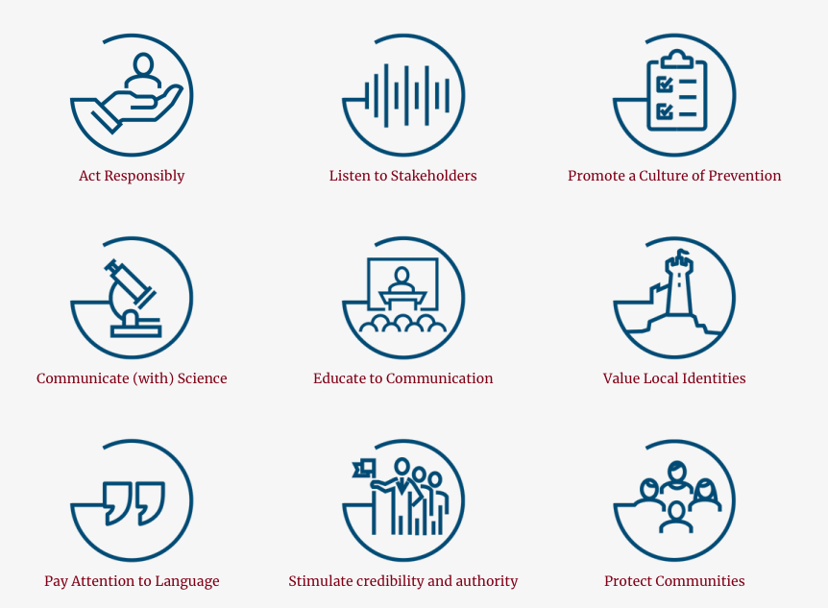
9 behaviors to be adopted in contexts of environmental and natural crises

Slide 8
Case Histories

Slide 9
3 Earthquakes in Italy. Different approaches for similar issues
Public Authorities & Private Organizations. The biggest
issue: no crisis plan
Communication and information channels
Media relations and storytelling: an opportunistic
antidote to destruction
Rebuilding material and immaterial assets

Slide 10
Conclusions
The role of communication and public relations can go beyond the mere crisis communication, being
a champion of crisis management and also nurturing the immaterial asset of local communities.

Slide 11
Bibliography
Bibliography
AA.VV. (2015). Sendai Framework for Disaster Risk Reduction 2015-2030, https://www.unisdr.org/we/coordinate/sendai-framework, UNISDR.
AA.VV. (2013) Risks and Conflicts: Local Responses to Natural Disasters: Volume 14 https://www.emerald.com/insight/publication/doi/10.1108/S2040-7262(2013)14
AA.VV (2019) La Carta di Rieti – The Charter of Rieti, www.lacartadirieti.org
Arata G., (2016). Emergenza Social-Consigli per le istituzioni che usano i social media durante le crisi, testo consultabile al link: http://bit.ly/1Vrkvmz
Barone, G. e Mocetti, S. (2014). Natural disaster, growth and istitutions: A tale of two earthquakers, Journal of Urban Economics, vol. 84
Bertoldo, R. (2020). A comparative frame for a contextualised analysis of local natural risk management, International Journal of Disaster Risk Reduction. 52. 10.1016/j.ijdrr.2020.101945.
Brondi S., Benedetti L., Tanga R., Bertoldo R. (2021). Between oblivion and drastic evidence: How local communities cope with seismic risk by forgetting and remembering, International Journal of Disaster Risk Reduction. 56. 102132. 10.1016/j.ijdrr.2021.102132.
Ciancio R. et al. (2019), The Role Of Active Relationship Governance In Building Social Capital, Improving Trust And Reinforcing Reputation, paper at BledCom 2019 https://cdn.ferpi.it/media/post/ut3epqg/BLED-COM%202019_paper%20FINAL.DEF_eng.pdf
Citarella, P. (2017). Social Media e P.A. La comunicazione istituzionale ai tempi di Facebook, Franco Angeli.
Esposito F., Russo M., Sargolini M., Sartori L., Virgili V. (a cura di) (2017). La responsabilità della comunicazione in Building Back better: idee e percorsi per la costruzione di comunità resilienti, Carocci Editore.
Gioia E., Casareale C., Colocci A., Zecchini F., Marincioni F. (2021). Citizens’ Perception of Geohazards in Veneto Region (NE Italy) in the Context of Climate Change, Geosciences, 10.3390/geosciences11100424, 11, 10, (424).
Imperiale, A.J. and Vanclay, F. (2019). Reflections on the L’Aquila trial and the social dimensions of disaster risk, Disaster Prevention and Management, Vol. 28 No. 4, pp. 434-445.
Martello, S. (2018). La gestione della crisi negli enti di terzo settore. Dinamiche ricorrenti e possibili soluzioni, Cesvot.
Martello, S., Oppi, B. (a cura di) (2016). Disastri naturali: una comunicazione responsabile? Modelli, casi reali e opportunità nella comunicazione di crisi, Bononia University Press.
Martello, S., Oppi, B. (a cura di) (2017). Disastri naturali: una comunicazione responsabile? L’Aquila, l’Emilia-Romagna e il Centro Italia. Verso un modello strutturato di ascolto e di resilienza, Bononia University Press.
Martello,S., Zicari, S. (2014). Tra profit e non profit. Le regole per una alleanza efficace., Cesvot.
Oppi B. (2021) Corpi intermedi &amp; sviluppo sostenibile, Bledcom 2021, to be published in the meeting proceedings
Poma L., Vecchiato G. (2019) La guida del Sole 24 Ore al crisis management. Come comunicare la crisi: strategie e case history per salvaguardare la business continuity e la reputazione, Edizioni Sole 24 Ore
Pompili D., Martello S., Oppi B., (a cura di) (2018). Call to action per una comunicazione responsabile. Verso la carta di Rieti, Bonomia University Press.
Rotolo F. (2021) BledCom Symposium 2021. Appunti di viaggio (virtuale) in Ferpi.it https://www.ferpi.it/news/bledcom-symposium-2021-appunti-di-viaggio-virtuale
Sheehan M., Quinn-Allan, (a cura di) (2015). Post crisis: rebuilding a company, a reputation, a community in Crisis Communication in a Digital World, Cambrige University Press.
Zhou, S., Battaglia, M. and Frey, M. (2018). Organizational learning through disasters: a multi-utility company’s experience, Disaster Prevention and Management, Vol. 27 No. 2, pp. 243-254.

